Slide 1
Insights
A morphologically-detailed neuronal network simulation library for contemporary high performance computing architectures
12th December 2018 I Alexander peyser & Anne Küsters

Slide 2
Agenda
Insights into Arbor
Introduction
Features
Model
Performance
Hands-on session
Build and run a ring network with python

Slide 3
recent collaborators
From different institutions
Ben Cumming
Stuart Yates
Nora Abi Akar
Vasileios Karakasis
Alexander Peyser
Wouter Klijn
Anne Küsters
Felix Huber
Simon Oerl
Susanne Kunkel
openly available @ https://github.com/arbor-sim/arbor

Slide 4
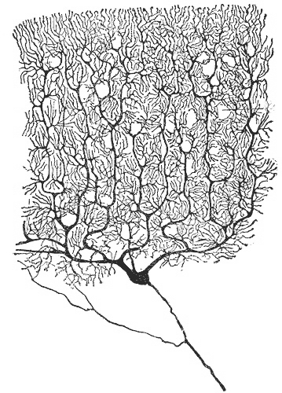
what is arbor?
A morphologically-detailed neuronal network simulation library for contemporary HPC architectures
A library for the simulation
of large networks of morphologically-detailed, spiking neurons
for all HPC systems in the HBP
Runs on multiple architectures
GPU systems,
vectorized multicore,
Intel AVX and laptops
Modular design for extensibility to new computer architectures
Purkinje cell by Santiago Ramón y Cajal
Notes:
Purkinje cell

Slide 5

Why arbor?
To solve multi-compartment simulations with large networks on new HPC architectures
Problems and models that are challenging to explore with current software and systems, e.g.
Near real-time multi-compartment simulations
Large networks with long simulations, parameter search, statistical validation
Field potential calculations of large networks with volume visualization
Adapting existing simulators to new HPC architectures is hard, e.g. for
Highly parallel architectures such as Intel Xeon and Intel KNL
Wider vector operations such as AVX, AVX2, AVX512
Specialized accelerator hardware as GPUs
Source of picture: flaticon.com
Notes:
Flaticon.com

Slide 6

Features of Arbor
Aiming for interoperability by being a simulator as library
* available soon
Interoperability Simulator as library
Extensibility Modular internal API
Performance HPC targeted
Multi-physics: can be integrated with other tools
Visualization (with coupling to in-situ visualization and analysis tools*)
Usability: installable target and simple configuration, python front-end (as basis for PyNN integration*), efficient sampling of voltage and currents
Multi-scale from single neurons to large multi-compartmental networks
Source of picture: flaticon.com

Slide 7
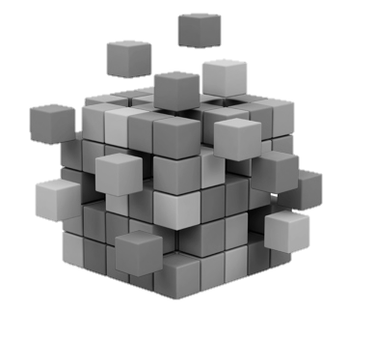
Features of Arbor
Aiming for Extensibility by having modular internal API
* available soon
Interoperability Simulator as library
Extensibility Modular internal API
New integration schemes, (high-order time stepping, error control, and efficient gap junction schemes*)
Custom spike communication and event systems, API for receiving spikes live from external simulators (e.g. NEST*)
Performance HPC targeted
Specialized cells: leaky integrate-and-fire, Hodgkin-Huxley, Poisson spikes
Source of picture: CitiXsys
Notes:
Copyright© 2018.CitiXsys Americas Inc.

Slide 8

Features of Arbor
Aiming for high performance on HPC targets
* available soon
Interoperability Simulator as library
Extensibility Modular internal API
Performance HPC targeted
Highly parallel and performance portable with task-based threading implementation, GPU and SIMD vector targets using NMODL and modcc
Design for scalability with fine-grained allocation of CPU and GPU resources
Unit testing, continuous integration*, validation and a benchmarking suite*
Reporting on memory and energy consumption
Source of picture: flaticon.com
Notes:
Flaticon.com

Slide 9
Introduction
Summary
Arbor is a new library for simulation of morphologically detailed spiking network
Specialized for GPUs, vectorized multicore, AVX and laptops
Designed to handle very large, very long and computationally intensive problems
Goals:
Interoperability with visualizations and simulators at other scales/problems
Modular internal API for extensibility for custom integration, spike communication and cell types
And targeted to highly parallel architectures, both existing and emerging
with an open development model, validation and testing

Slide 10

Neuron Model
Arbor simulates networks of multi-compartment neurons
Neurons: approximated by axonal delay, synaptic functions and a set of cables (for dendrites + soma) connected in a tree.
Cables: characterized as 1D electrical compartments (of variable diameter) composed of ion channels, cable resistance and capacitance.
Neurons represented as sparse, close-to-band matrices to be solved (e.g. by Hines solver) against known current states due to synaptic conductance.
Network and spike exchange between neurons at synapses are represented by concatenations of matrices.
Source: Koch, Methods in Neuronal Modeling: From Ions to Networks

Slide 11
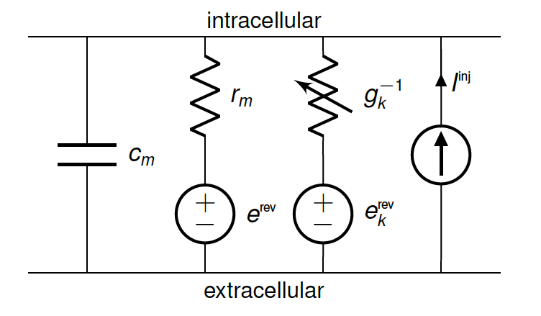
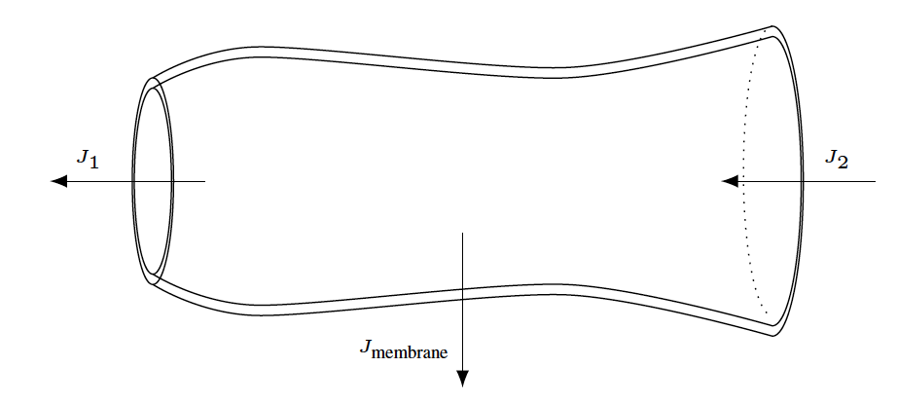
Cable Equation
A cell is modelled as a branching, one-dimensional electrical system
, where
with
Axial conductivity of the intracellular medium
Membrane areal capacitance , areal conductance for an ion channel of type as a function of channel’s state
Corresponding reversal potential
Membrane surface area as a function of axial distance
Current produced by a synapse at position as a function of the synaptic state and local voltage
Injected current at position
Notes:
f_k, f_k^syn biophysical properties of the ion channels and synapses, and will vary from simulation to simulation

Slide 12
Numerical Model
Cell state evolution is numerically solved with first order methods
Space discretization: Vertex-centered 1D finite volume method using first-order approximation for axial current flux with
Voltage and channel state time evolution split: Lie-Trotter
Time discretization: First-order implicit Euler integration
Channel state ODEs: Integration with updated voltages depending on set of ODEs

Slide 13
Cell simulation
Most time consuming parts on a CPU are updating currents and integrating gating variables

Slide 14
Design model
Scalability through the abstraction of recipes
Cells
Recipes
A “cell” represents the smallest model to be simulated
A “cell” forms the smallest unit of work distributed across processes
Types:
Specialized leaky integrate-and-fire cells
Artificial spike sources
Multi-compartment cells
A “recipe” describes models in a cell-oriented manner and supplies methods to
Map global cell identifier gid to cell type
Describe cells
List all connections from other cells that terminate on a cell
Advantage: parallel instantiation of cell data

Slide 15
Design model
Extensibility through cell group abstraction
Cell groups
Mechanisms
A “cell group” represents a collection of cells of the same type together with implementation of their simulation
Partitioning into cell groups provided by decomposition
A “simulation” manages instantiation of model and scheduling of spike exchange as well as integration for each cell group
In a recipe, mechanisms are specifications of ion channel and synapse dynamics
Implementations of mechanisms:
Hand-coded for CPU/ GPU execution or
A translator (modcc) is used to compile a subset of NEURONs mechanism specification language NMODL to architecture-optimized vectorized C++ or CUDA source

Slide 16
Model
Summary
Arbor models:
Multicompartment neurons using a cable model transformed into a sparse matrix
Neurons characterized by axonal delays, synaptic functions and cables connected in a tree
Spike exchanges are global across computer nodes, functionally concatenating matrices
Numerical solutions are discretized in time and space, and channel states are discretized ODEs
Accelerator (GPU) optimization is focused on updating currents and integrating gating variables
Models are composed of:
Cells representing the small unit of computation (LIF, Artificial sources, Multicompartment cells)
Recipes representing a parallelizable set of neuron construction and connections
Cell groups computed together on the GPU or CPU
Mechanism representing ion channel and synapse dynamics

Slide 17
SPIKE EXCHANGE
With a minimum delay
Overlapping computation and communication with a minimum spike propagation delay
Integration of states in epoch requires spikes from epoch and are exchanged in epoch .
Reason: latency hiding
Notes:
epoch: Dt/2

Slide 18
Design model
Programming interface ensures extensibility
Components can be substituted according to the internal API.
Models are described in NMODL, a DSL used for the NEURON simulator.
Python interface for building networks is under development.

Slide 19
Design model
Computational work is hidden in backends
Cell simulation modules share computational backends for channel and synapse state evolution.
CPU-hosted finite volume cell simulation.

Slide 20
Structure
Summary
Spikes are exchanged at ½ the minimal spike propagation delay to overlap computation and communication
Internal API uncouples model description, execution, spike exchange and cell simulation
Computational work is hidden in pluggable backends, allowing automatic generation for different architectures
Python interface is under development

Slide 21
vectorization PERFORMANCE
Used systems and benchmark model
Systems
Benchmark model
Cells: 300 compartments with Hudgkin-Huxley mechanisms, 5.000 randomly connected exponential synapses
Network: 100 cells per single core 1000 cells per socket
Duration: 100 ms

Slide 22
vectorization Performance
Comparison of explicit vectorization relative to the compiler’s auto-vectorization
Speedup of total time to solution with vectorization
1.5 x for Broadwell socket
3.4 x for KNL socket
Use of data-pattern optimized loads and stores contributes to speedup.
Less improvement for Broadwell due to poor performance of vectorized division.

Slide 23
Performance benchmarks
Setup of ring network on HPC architecture
System
Ring model
Cells: Randomly generated morphologies with on average 130 compartments
Synapses: 10 000 exponential synapses per cell with only one synapse connected to a spike detector on the preceding cell
Soma: Hodgkin-Huxley mechanism;
Dendrites: Passive conductance

Slide 24
Performance
Single node scaling - time: utilization of computational resources on one node at various model sizes
Models with fewer cells take less time to execute
Scaling is architecture and model size dependent
MC scales well for 64 or more cells
KNL scales well for 512 or more cells
GPU scales well for 1024 or more cells
Below scaling thresholds node resources are under-utilized
GPU catches up at 4000 cells

Slide 25
Performance
Single node scaling – speedup: comparison with NEURON
Memory
Arbor significantly more memory efficient with 4.4 GB for 16k model,
NEURON unable to run 16k model due to running out of 64 GB memory available on Daint-mc
Speedup
Arbor is faster for all model sizes with speedup increasing with model size
5-10x faster for less than 128 cells
over 20x faster for more than 256 cells
Notes:
NEURON
most widely-used software for simulating networks of multi-compartment cells
supports running large models in parallel using multi-threading and MPI
becomes DRAM bandwidth bound, due to the larger model state and because cells are grouped and integrated together in a way that doesn’t retain cell state in cache
ARBOR
smaller models: faster because of a more efficient structure-of-array (SoA) memory layout and vectorization compared to NEURON’s array-of-structure (AoS) layout
larger models: Arbor is optimized to keep cell state in L2 and L3 cache

Slide 26
Performance benchmarks
Setup of connectivity model on HPC architecture
System
10k connectivity model
Cells: As in ring model with 16k cells for duration of 100 ms
Network: 10 000 way randomly connected with no self-connections
Minimal delay: 10 ms or 20 ms
Synapses: All excitatory
Spiking: All cells spike synchronously with frequency 100 Hz or 50 Hz

Slide 27
Performance
Strong scaling: minimizing time to solution for a fixed model size with increasing number of nodes
For less than 4k cells (on 4 nodes) multicore and GPU are equivalent (within 10% range)
For more than 4k cells multicore is faster
A KNL node is uniformly slower than multicore, using 1.4x more time
Still, Arbor can be used effectively on an HPC system available

Slide 28
Performance
Strong scaling efficiency
Resource utilization is effective where strong scaling efficiency is good
Efficiency decreases as the number of nodes increases
Only the multicore system scales with 90% efficiency to 64 nodes (256 cells per node) and minimizes time-to-solution
GPU system is still effective for running large models

Slide 29
Performance
Strong scaling: consumed resources in node-seconds and energy consumption
Notes:
node-second=simulation time x nodes

Slide 30
Performance benchmarks
Setup of dry-run mode on HPC architecture
System
Dry-run mode
Model: 100 ms simulation with 10 ms delay and cells firing at 87.5 Hz each cell connected to 10 000 random cells with no self-connection
Mode: Run model on single MPI rank, and mimic running on a large cluster (here: 10 000 nodes) by generating proxy spikes from cells on other ranks
Cells/ node: 1000 & 10 000 cells per node for total model size of 10 M & 100 M cells

Slide 31
Performance
Weak scaling is near perfect
Maximize model size while increasing number of nodes with fixed number of cells
To hundreds of nodes
Arbor weak scales (near) perfectly on multicore and GPU

Slide 32
Performance
Weak scaling sufficient with 80% at extreme scale
To 10 000 nodes
1000 nodes: 1k and 10k models weak scale very well with 99% and 95% efficiency
10 000 nodes: weak scaling still good with 87% and 79% for 1k and 10k models, but decreased due to spike communication and processing

Slide 33
Performance
Summary
Arbor has been tested on a variety of vectorized CPU architectures, showing significant improvement over compiler auto-vectorization
Synthetic networks have been tested on multicore, GPU and KNL architectures
Close to linear single node scaling, with comparable performance at >1000 cells
More memory efficient than standard NEURON, with speedup’s of 5-30x as cell numbers increase
Strong scaling has been shown for up to 10k cells with good energy consumption scaling
Weak scaling is near perfect up to 128 nodes (1 million cells)
Even at 10k nodes, weak scaling is still at 79%

Slide 34
Conclusion
Summary
Arbor is an extensible library for multicompartment neuron models
It is designed with the goal of optimizing usage of current HPC architectures and is ready to be ported to future architectures
Development is fully open, developed from scratch, developed by software engineers at supercomputing centers
It uses standard cell and network formalisms with a focus on performance
A subset of NMODL descriptions can be used
A python interface is under development
We have focused on synthetic verification, testing and performance benchmarks
Current architectures are standard cpus, vectorized cpus, many core and GPUs
Weak and strong scaling have been shown up to 10 000 nodes
5-30x faster than standard NEURON for tested morphologies and networks

Slide 35
Questions
Notes:
Flaticon.com

